Slide 1
DataFrame of <span, entity type> pairs
Entity spans in document context
DataFrame of raw token labels
Data entry pane

Slide 2
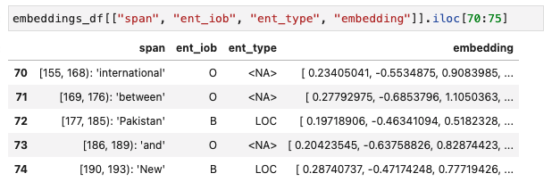
BERT embedding at each token position (tensor dtype)
Span of each token (span dtype)
Labels from corpus

